Slide 1
Basic Concepts of Socket Programming
Mohammad Ashraful Islam
Lecturer
Department of CSE
Jahangirnagar University

Slide 2
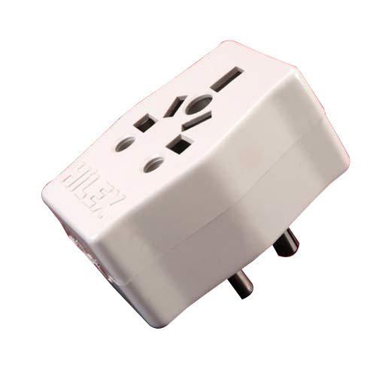

What is Socket?

Slide 3
What is Socket?
A socket is one endpoint of a two-way communication link between two programs running on the network. A socket is bound to a port number so that the TCP layer can identify destination of data to be sent.

Slide 4
Socket Programming
  Socket programming is a way of connecting two nodes on a network to communicate with each other.
  One socket(node) listens on a particular port at an IP,
  Other socket reaches out to the other to form a connection.
  Server forms the listener socket while client reaches out to the server.

Slide 5
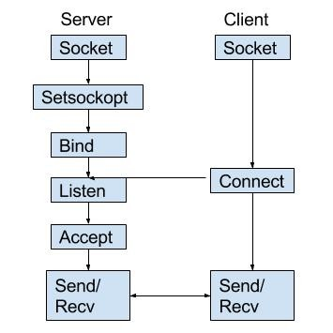
Client-Server Communication

Slide 6
Client-Server Communication using C++
System Requirement
IDE: CodeBlock
MinGW : Updated Version
C++ 11 or above
Two PC cable connected PC.

Slide 7
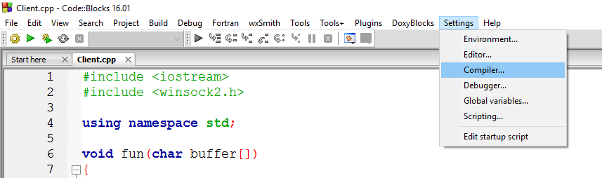
Configuring CodeBlock
Settings→ Compiler→

Slide 8
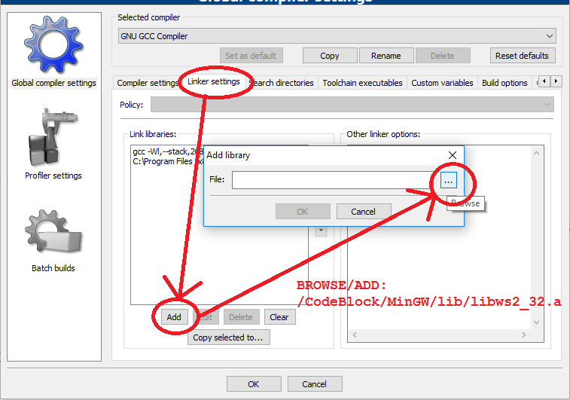

Slide 9
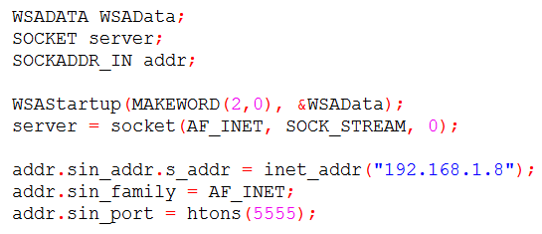
Client Side
  What we need?
    Call Windows Socket function Startup Application
    We need one Socket through which server will listen.
    That Socket must have an address.

Slide 10
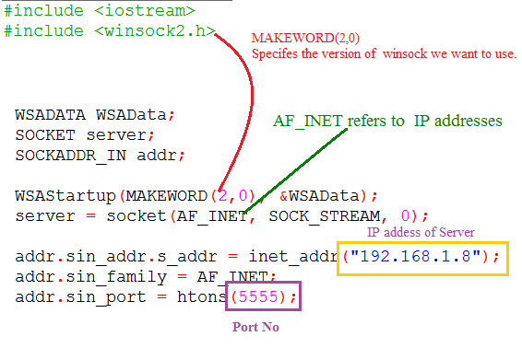
Client Side

Slide 11
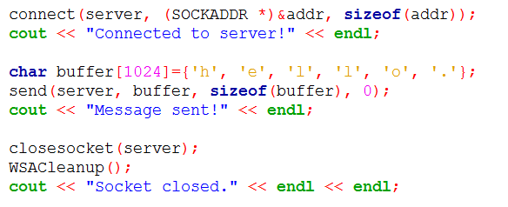
Client Side
Now just connect to the server and send message.
That’s all for Client.

Slide 12
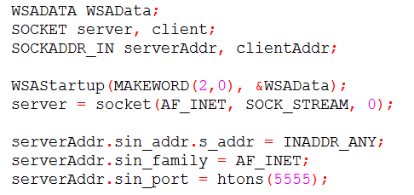
Server Side
Just Same as you configured Client
Two sockets and addresses (one as a server & another for communication with its client)

Slide 13
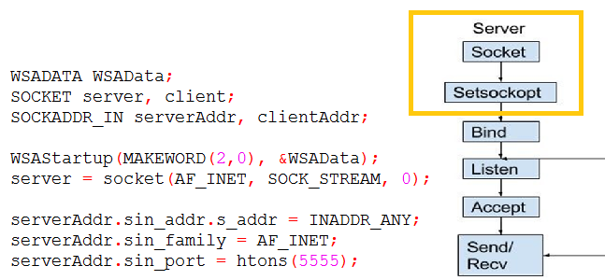
Server Side
That’s all for Client.

Slide 14
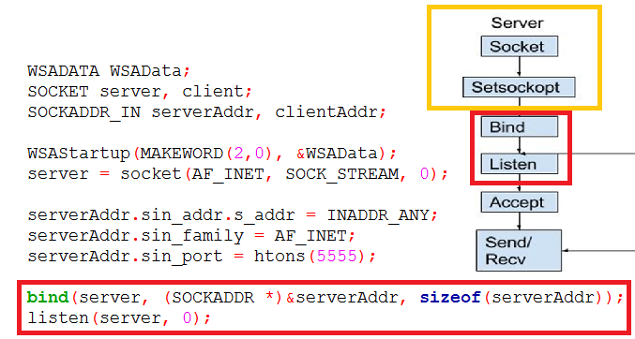
Server Side

Slide 15
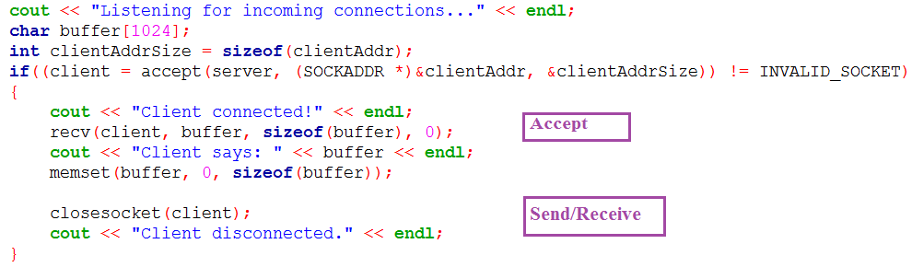
Server Side
THAT’S ALL

Slide 16
Issues May Arise
When you run server side application, windows may block your application or will ask for permission
Message from client may not be sent to the server due to windows firewall.
Check IP address of client & server, make sure their net id is same.
If port is not available, change the port number and try again.

Slide 17
Thank You

